Slide 1

Submitted by Shiva Gujria

Slide 2
Introduction
Hello ! Greetings to all .I am here to share my insights for the company sales performance for the year of 2011.
I appreciate TATA Group from providing me chance to gain insightful information from the data of store's Performance.
Thanks to CEO and CMO for questions asked to me and provide direction for the insights of the data.

Slide 3
Thought Process
I assure you that I look all the necessary steps to ensure that this analysis is accurate and correct.
I cleaned up the data you provided by removing all the negative values in the Unit Price and Quantity columns and also filtered the data as required for all the visualizations.

Slide 4
Question 1
The CEO of the retail store is interested to view the time series of the revenue data for the year 2011 only. He would like to view granular data by looking into revenue for each month. The CEO is interested in viewing the seasonal trends and wants to dig deeper into why these trends occur. This analysis will be helpful for the CEO to forecast for the next year.

Slide 5
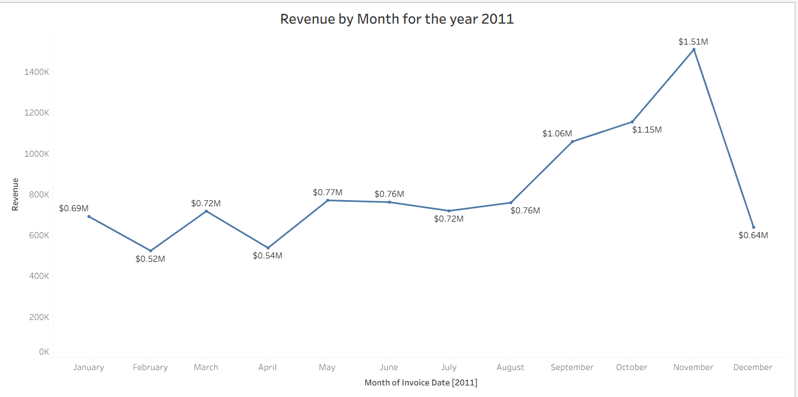
The first 8 months had stable monthly revenue with an average of 685 k. The revenue trend from August to December how seasonally affects retail store sales.

Slide 6
Question 2
The CMO is interested in viewing the top 10 countries which are generating the highest revenue. Additionally, the CMO is also interested in viewing the quantity sold along with the revenue generated. The CMO does not want to have the United Kingdom in this visual.

Slide 7
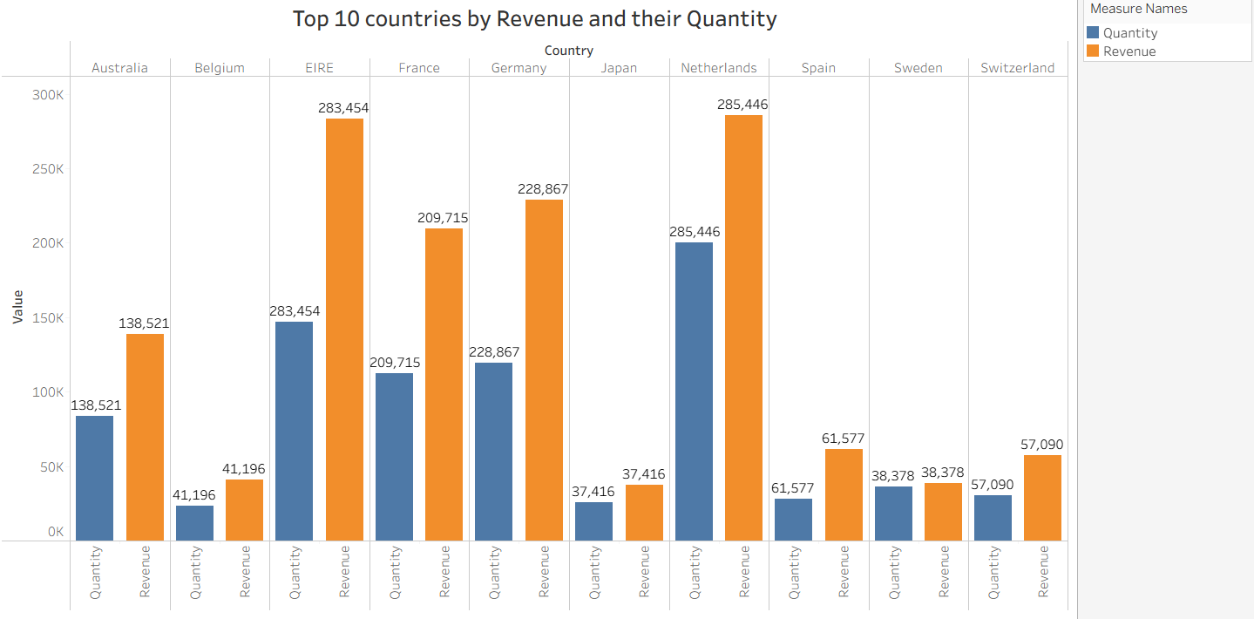
• This chart represents the top 10 countries in revenue and the quantities bought in these countries except The United Kingdom.
• There is no major difference between the revenue and the quantity of goods sold in these countries ,showing high purchasing power in these countries

Slide 8
Question 3
The CMO of the online retail store wants to view the information on the top 10 customers by revenue. He is interested in a visual that shows the greatest revenue generating customer at the start and gradually declines to the lower revenue generating customers. The CMO wants to target the higher revenue generating customers and ensure that they remain satisfied with their products.

Slide 9
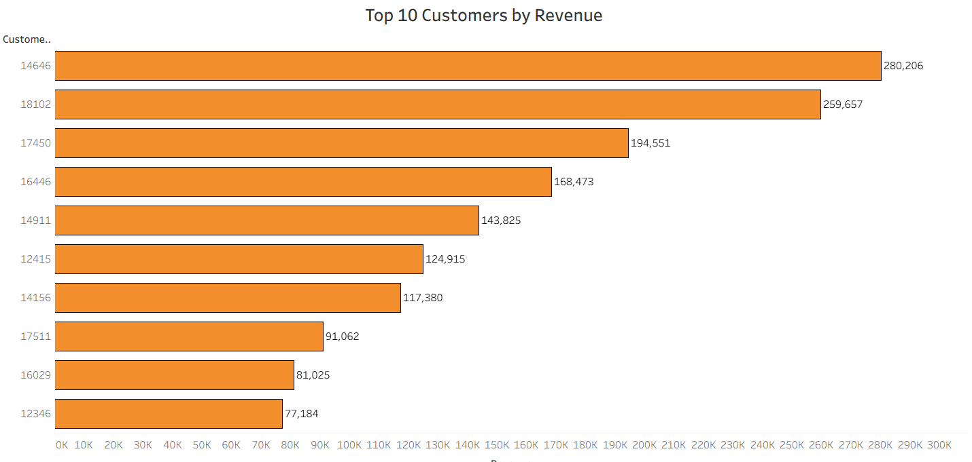
The averge difference in revenue between the top 1o countries is 15.8%.
The company can aim to strengthen the relationships with these customers to increase customers loyality and retention and ultimately drive more sales and revenue for the company.

Slide 10
Question 4
The CEO is looking to gain insights on the demand for their products. He wants to look at all countries and see which regions have the greatest demand for their products. Once the CEO gets an idea of the regions that have high demand, he will initiate an expansion strategy which will allow the company to target these areas and generate more business from these regions. He wants to view the entire data on a single view without the need to scroll or hover over the data points to identify the demand. There is no need to show data for the United Kingdom as the CEO is more interested in viewing the countries that have expansion opportunities.

Slide 11
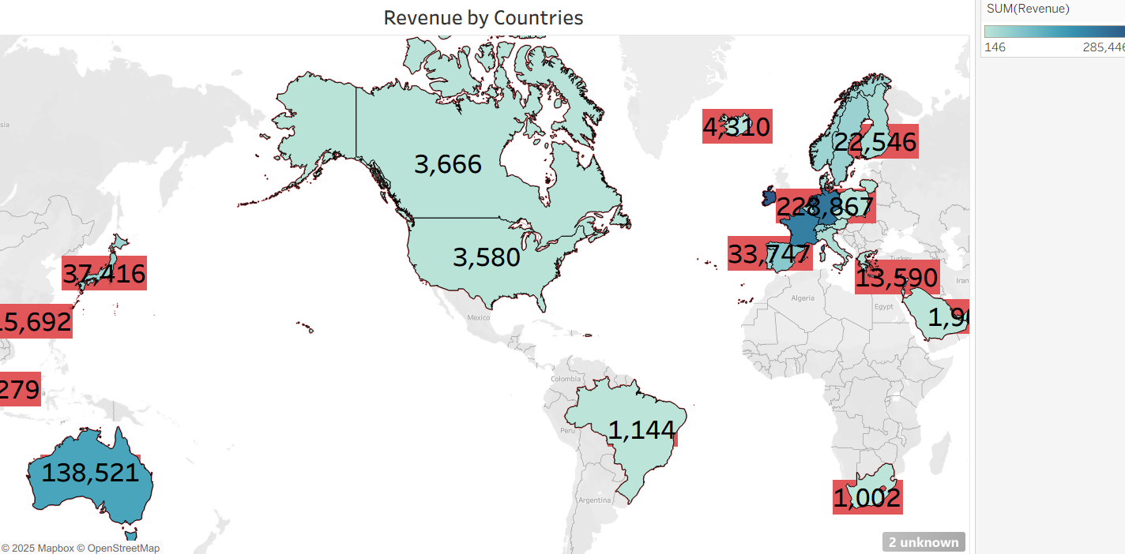
The map chart concludes by comparing the places that have produced the greatest revenue to those that have not.
There is no market in Africa, Asia and Russia.
The map also revels that the majority of sales only in European market more and dive deeper into these region to maximize sales.

Slide 12
Recommendations
• The company should come up with strategies that aim at
Stocking and advertising seasonal products to maximize sales when
the demand go up.
• The company should create special relationship with the customers
Who order in big quantities in order to increase the retention .
• The European market has more potential to grow sales hence
Company should build strategies to maximize the sales .

Slide 13
Thank You

